Slide 1
RAG Pipelines

Slide 2
Agenda
Introduction to Retrieval-Augmented Generation (RAG)
Key Components of RAG Pipelines
Document Processing: Chunking & Embedding
Overview of QA System Implementation

Slide 3
Introduction to Retrieval-Augmented Generation (RAG)
Definition: Retrieval-Augmented Generation is an approach where LLMs are augmented with a retrieval system to fetch external, relevant data before generating responses.
Motivation:
Enhances answer accuracy and reduces hallucinations.
Combines strengths of both retrieval methods and generative models.

Slide 4
RAG Architecture Overview
Two Main Components:
Retrieval Module: Uses vector stores to fetch relevant documents based on query embeddings.
Generation Module: An LLM (e.g., GPT-3.5) that synthesizes a final answer using the retrieved context.
Workflow:
Input query → Retrieval of supporting documents → LLM generates answer using both the query and retrieved context.

Slide 5
Document Processing: Chunking & Embedding
Document Chunking:
Splitting long documents into manageable passages.
Ensures retrieval granularity and relevance.
Embedding Generation:
Converts text chunks into high-dimensional vectors.
Facilitates efficient similarity search in the vector store.
Key Aspect:
Maintaining the balance between chunk size and context completeness.

Slide 6
QA System Implementation: End-to-End Flow
Step-by-Step Process:
Document Ingestion:
Loading and preprocessing documents (e.g., PDF files or text excerpts).
Chunking & Embedding:
Splitting documents and generating embeddings.
Query Processing:
Transforming the user query into a vector.
Retrieval:
Searching the vector store for contextually similar passages.
Answer Generation:
The LLM synthesizes a response using the retrieved data.
Example Query: “Explain gradient descent.”

Slide 7
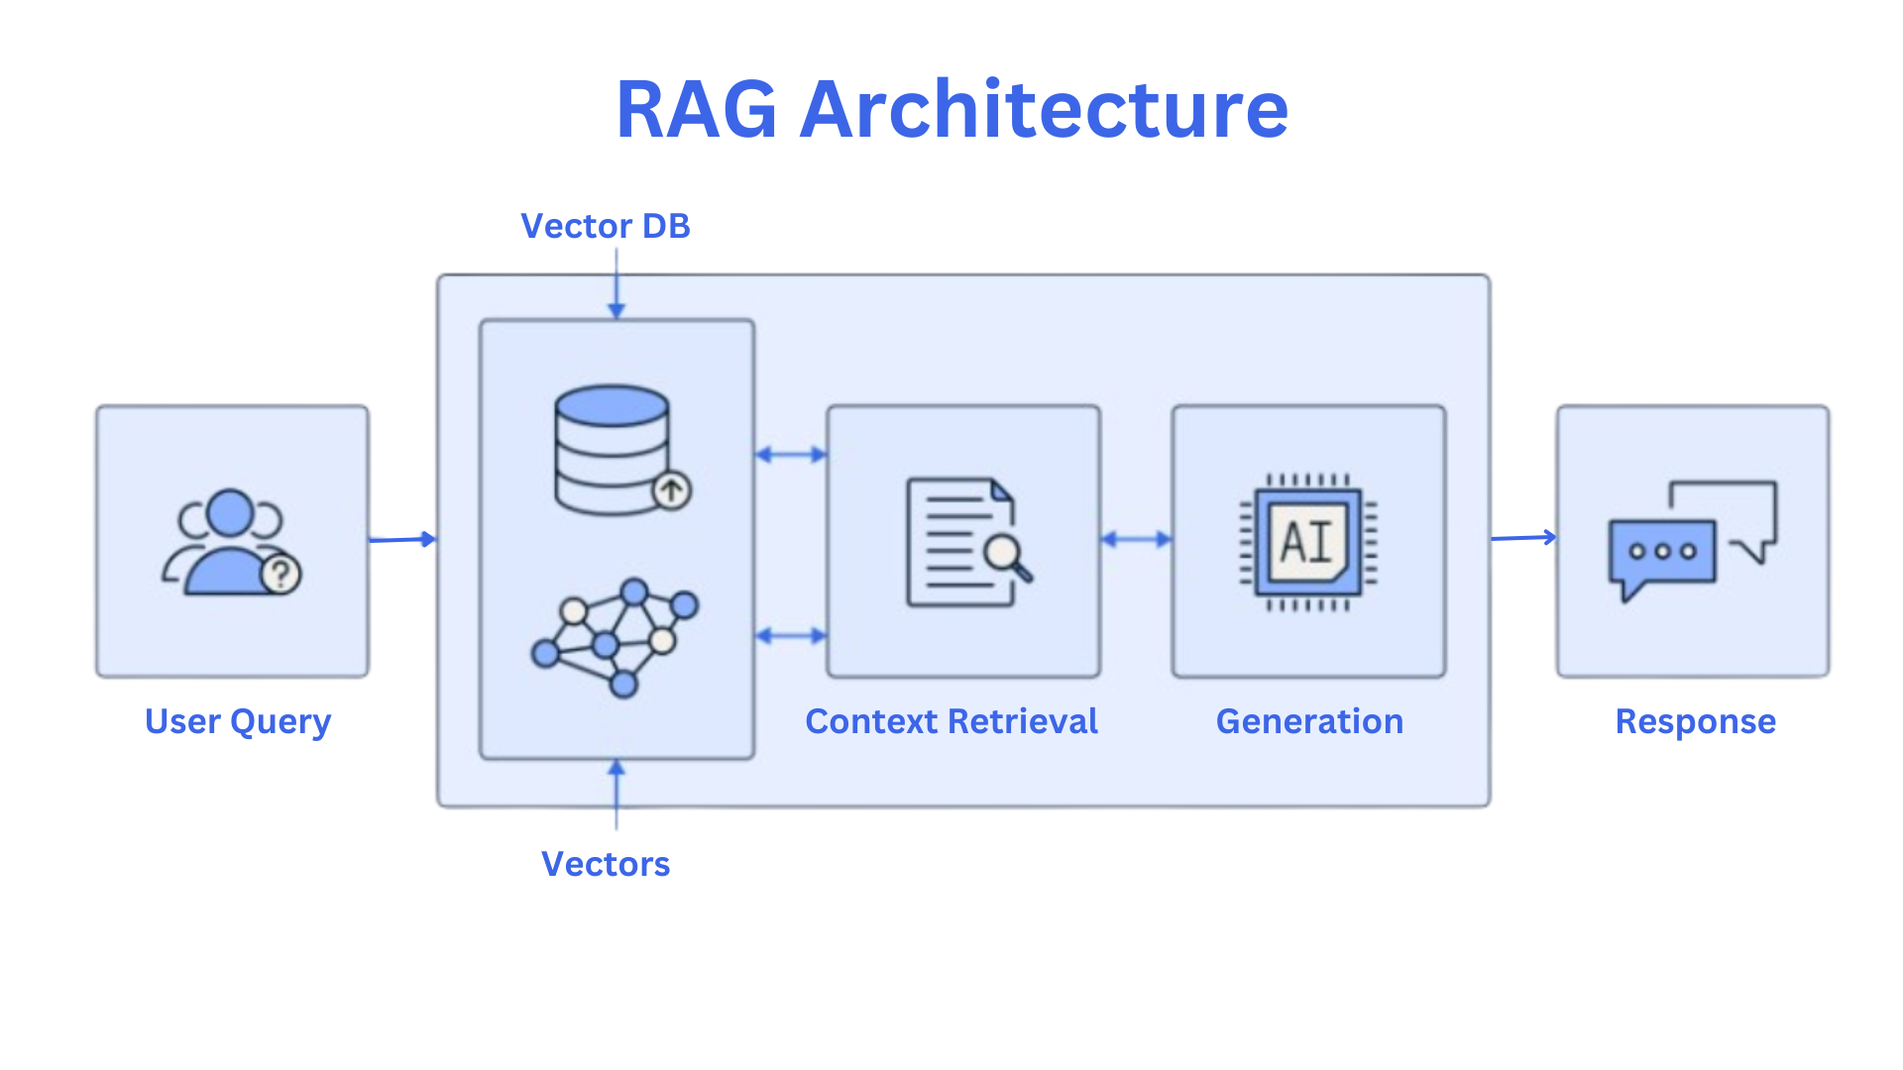

Slide 8
End-to-End RAG Implementation
Objective: Apply the RAG concepts to build a complete question-answering system.
Tasks Include:
Document ingestion (e.g., PDFs or text files).
Document chunking and embedding generation.
Query processing and retrieval via a vector store.
Integrating the retrieval output into an LLM for answer synthesis.

Slide 9
Instructions
Step 1: Document Ingestion & Preprocessing
Collect and pre-process documents (cleaning and formatting).
Step 2: Chunking and Embedding Generation
Divide documents into manageable chunks.
Generate embeddings using models like Sentence-BERT.
Step 3: Retrieval Phase
Insert embeddings into a vector store (e.g., using FAISS).
Convert the user query to an embedding and retrieve top relevant chunks.
Step 4: Generation Phase
Pass the query along with the retrieved context into an LLM (e.g., GPT-3.5) for generating a detailed answer.
Step 5: System Testing
Run sample queries and compare the generated answers against ground-truth data.

Slide 10
Evaluation Metrics for RAG Systems
Faithfulness:
How closely does the generated answer reflect the retrieved context?
Relevance:
Evaluate if the retrieved documents contribute meaningful information to the final answer.
Coherence and Clarity:
The overall logical flow and readability of the generated answer.
Precision/Recall:
Quantitative measures if a ground-truth reference is available.
Latency:
Time taken to complete the retrieval and generation process.

Slide 11
Discussion
What challenges did you face during retrieval or generation?
How did the RAG system’s performance compare against your expectations?
What improvements do you foresee for your pipeline?

